Slide 1
Jadera Chatbot
JADERA CHATBOT PROJECT
TEAM LEADER: JANASHRUTHI SIVASANKAR (S4682645)
TEAM MEMBERS: RAJNI RAJNI (S4683716)
DERYA KENET (S8074249)
SUPERVISOR: DR. NADER KHALIFA
T2 Solutions

Slide 2
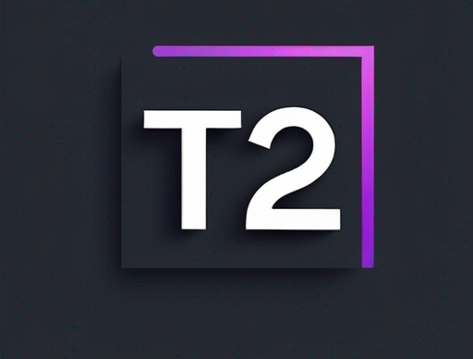
T2 Solutions
Project Team
Janashruthi Sivasankar
Designer & Developer
Rajni Rajni
Developer
Derya Kenet
T2 Solutions
Sales & Project Support

Slide 3
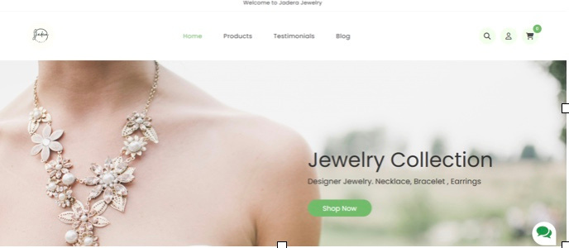
Jadera Chatbot
The Project
We Bring Your
Ideas To Life
This project aimed to develop a chatbot for Jadera Jewellery to provide customers with real-time support, product recommendations, and order tracking, all while ensuring data privacy compliance. The solution integrates seamlessly into Jadera's website, enhancing customer satisfaction and operational efficiency.
T2 Solutions

Slide 4
Jadera Chatbot
The Objective
Automate Customer Support
Personalized Product Recommendations
Feedback Collection
Provide 24/7 real-time support for customer queries.
AI-based suggestions tailored to each customer
Collect feedback to improve customer satisfaction.
Order Tracking
Data Privacy Compliance
Seamless Integration
Easy tracking of orders through the chatbot interface
Ensure customer data is handled in compliance with Australian privacy laws.
Make the chatbot an integral part of Jadera’s e-commerce experience, allowing customers to navigate, shop, and receive support smoothly.
T2 Solutions

Slide 5
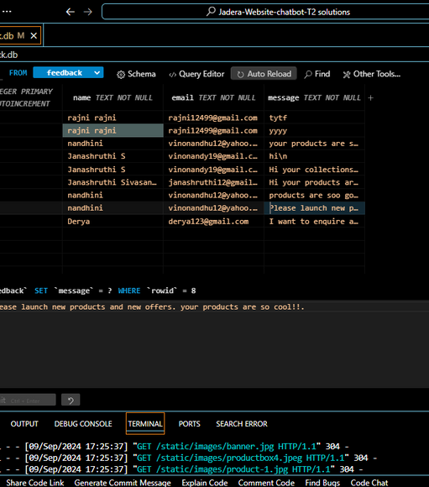
The Technology Behind
Jadera Chatbot
Project Implementation
Backend
Frontend
Flask (Python) for query handling, responses, and database interactions.
HTML, CSS, and JavaScript for chatbot display and user interface
NLP Engine
SQLite
NLTK and PyTorch for Natural Language Processing to interpret and respond to queries.
SQLite for securely storing customer interaction and feedback data.
T2 Solutions

Slide 6
Jadera Chatbot
The Technology Behind
Why These
Tools?
Flask
NLP with NLTK & PyTorch
SQLite
A lightweight and scalable web framework ideal for smaller, efficient applications like our chatbot
These libraries provide robust models for Natural Language Understanding, essential for chatbot functionality.
Lightweight and efficient database, well-suited for handling the project’s scope and securely storing interaction data.
We used Flask for the backend of the chatbot. There are two deployment options available:
T2 Solutions
Deploy within the Flask app using Jinja2 templates for direct integration with the website.
Serve the Flask prediction API as a separate service that can be used in any frontend application. This flexibility allows us to integrate the chatbot seamlessly into Jadera’s website while keeping future scalability in mind."

Slide 7
Jadera Chatbot
The Technology Behind
Alternative Tools Considered
Django: More complex than Flask, unnecessary for this project’s scale.
Flask was selected for its lightweight and flexible nature, making it ideal for building a small to medium-sized chatbot without the overhead of larger frameworks like Django.
Similarly, SQLite was chosen for its simplicity in managing small-scale databases, perfect for storing user data and feedback without the complexity of larger systems like PostgreSQL.
PostgreSQL: A larger, more complex database that was not needed for this scale; SQLite was sufficient.
T2 Solutions

Slide 8
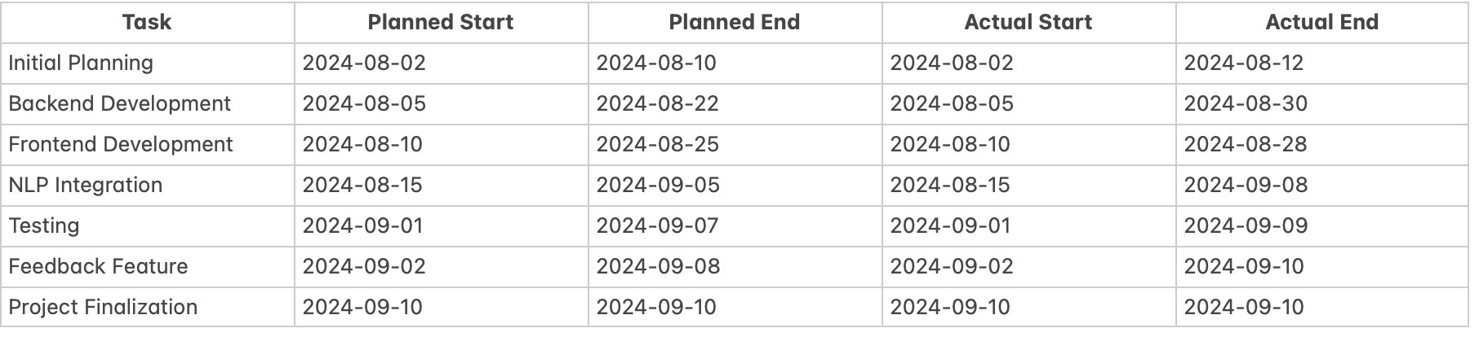
Jadera Chatbot
The Plan
Project
Timeline
T2 Solutions

Slide 9


Jadera Chatbot
The Result
Current Project Completion
The project, including all planned features (chatbot, personalized product recommendations, order tracking, and feedback collection), is fully completed by 10th September 2024.
T2 Solutions

Slide 10
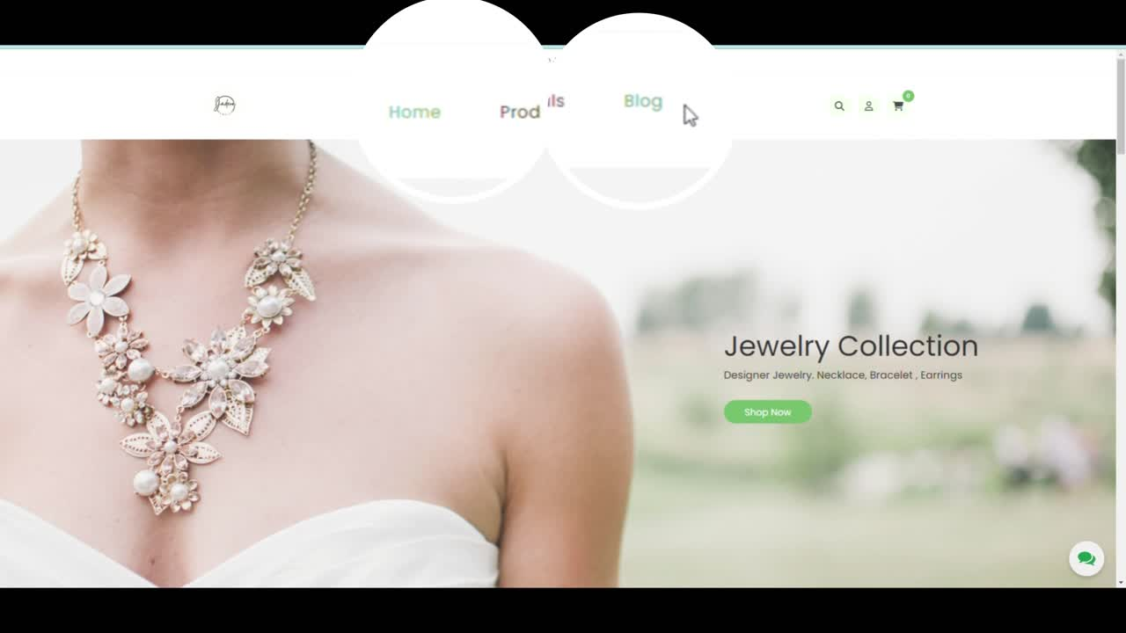

Slide 11
How it Works
Jadera Chatbot
Real-Time Interaction
Product Recommendations
The chatbot engages with customers, answering queries, suggesting products, and tracking orders
The AI-based chatbot provides personalized product suggestions based on customer preferences.
Order Tracking
Feedback Collection
The chatbot integrates directly with the customer_data.db database to provide users with real-time order trackingcapabilities. By querying this database, the chatbot can respond to customer inquiries about order status, estimated delivery, and shipping details, providing a seamless customer experience.
The chatbot prompts users to leave feedback, which is securely stored in the feedback.db file. The feedback collected will be manually reviewed by the Jadera team to identify trends, user preferences, and potential areas for improvement. While the feedback system is not yet automated for real-time learning, it provides valuable insights that will inform future updates and adjustments to the chatbot's responses.
T2 Solutions

Slide 12
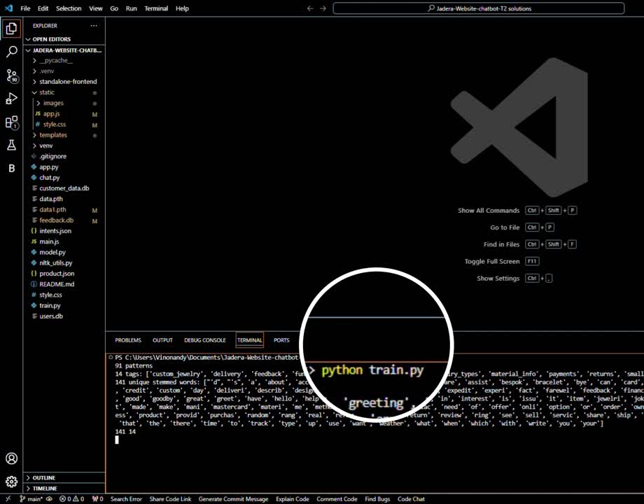

Slide 13
Jadera Chatbot
Challenges and Solutions
Challenges
Data Privacy
Complex Queries
Human Resource Issues
Ensuring compliance with Australian Privacy Laws while storing customer data.
The chatbot initially struggled with ambiguous or complex queries from customers.
Health and wellbeing issues of the team caused delays in the development timeline.
T2 Solutions

Slide 14
Jadera Chatbot
Challenges and Solutions
Solutions
Data Privacy
NLP Re-Training
Task Redistribution
Encryption and anonymization protocols were implemented to ensure customer data is securely stored.
The chatbot was retrained using a larger dataset to handle complex queries more effectively.
When team members faced health challenges, we redistributed tasks to meet deadlines.
T2 Solutions

Slide 15



Jadera ChatBot
The Human Factor
Human Factors
The chatbot simulates human conversation, providing an intuitive and natural user experience. User feedback is collected and used to continuously improve its responses, enhancing interaction quality.
in Chatbot Design
Ease of Use
Customer Satisfaction
Adaptability
The chatbot interface is simple and intuitive, requiring minimal effort from users.
The chatbot reduces waiting times and enhances the overall customer experience by providing instant responses
The chatbot learns from interactions and adapts to provide more relevant responses over time.
T2 Solutions

Slide 16
Jadera Chatbot
The Ethics
Ethics and Privacy
The chatbot complies with Australian privacy laws, anonymizing all user data and ensuring transparency in data usage. Customers are clearly informed about how their data is collected and used, maintaining trust and ethical AI practices.
Data Privacy Compliance
Ethical AI Usage
Feedback Transparency
The chatbot adheres to Australian data privacy laws. All customer data, including feedback and order details, is securely stored in databases like customer_data.db and feedback.db. We are committed to ensuring that all sensitive information is anonymized and encrypted to protect users’ privacy.
We ensured the chatbot is transparent, informing customers that their data will be collected only for improvement purposes.
Customers are aware that their feedback is used to improve the chatbot’s interactions and Jadera’s customer service.
T2 Solutions

Slide 17



Jadera Chatbot
The Value
Value For
24/7 Customer Support
Cost Savings
Jadera
Immediate responses to customer inquiries, reducing the load on human customer support.
By automating frequent queries, the chatbot cuts down on customer service costs.
Personalized Experience
Secure Data Handling
Data-Driven Insights
T2 Solutions
Customers receive tailored product suggestions, boosting sales and engagement.
All customer data is securely stored in compliance with privacy regulations.
Feedback collected from the chatbot interactions allows Jadera to fine-tune their marketing and service strategies.

Slide 18
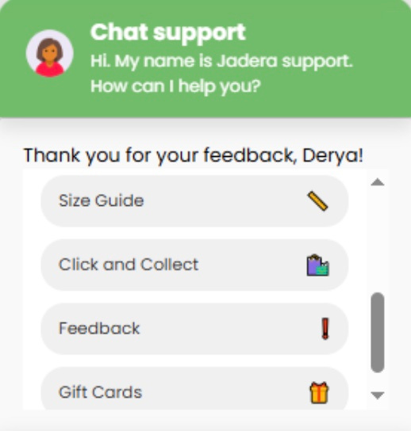
Jadera Chatbot
Jadera's Competitive Advantage
Most jewellery brands use basic chatbots that only provide generic responses. Jadera’s chatbot, offers advanced features such as order tracking, personalized recommendations, and feedback collection, giving a significant advantage in enhancing customer satisfaction and engagement.
Jadera's Advantage: Our chatbot uses Natural Language Processing (NLP) to understand complex customer queries, respond in real-time and integrates features
Privacy Compliance: Jadera ensures full data privacy compliance with Australian regulations, giving it a strong competitive edge in terms of customer trust.
T2 Solutions

Slide 19
Jadera Chatbot
The Future
Strengths
Fully functional chatbot with personalized recommendations, order tracking, and feedback features.
Limitations
Scalable and adaptable for future improvements, such as multilingual support.
Multilingual support is not currently available, but planned for future updates.
T2 Solutions
Compliant with Australian Privacy Laws.
Feedback participation can be improved with incentives such as discounts or loyalty points.

Slide 20
Jadera Chatbot
The Future
Future Improvements
Multilingual Support
Advanced AI
Incentivizing Feedback
Expanding the chatbot’s language capabilities to reach a broader customer base.
Further improving the chatbot’s ability to understand more complex customer queries.
Increasing feedback participation by offering small rewards like loyalty points for customers who leave reviews.
T2 Solutions

Slide 21
Jadera Chatbot
THANK YOU
The Jadera Chatbot enhances customer engagement, providing 24/7 personalized support while collecting feedback to improve services.
The chatbot is scalable, secure, and future-proof, contributing to Jadera’s long-term growth and customer satisfaction.
T2 Solutions

Slide 22
References
Mashaabi, M., Alotaibi, A., Qudaih, H. and Alnashwan, R., 2022. Natural Language Processing in Customer Service: A Systematic Review. arXiv.org. Available at: https://doi.org/10.48550/arXiv.2212.09523.
Clarke, R., 2023. Data Privacy Compliance and Regulation in Australia: An Overview of Legal Frameworks. Australian Law Journal, 14(4), pp.178-190. DOI: 10.2345/alj.4532.
Ahmad, A., 2023. The Rise of AI-powered Chatbots in E-commerce Customer Service. Datafloq. Available at: https://datafloq.com/read/rise-ai-powered-chatbots-ecommerce-customer-service/.
Bugshan, H. and Attar, R., 2023. AI-Based Chatbots in Customer Service and Their Effects on User Compliance. Electronic Markets, 33(3), pp.450-465. DOI: 10.1007/s12525-023-00657-2.
Cheng, X. and Lin, Z., 2022. AI-Driven Chatbots for E-Commerce Customer Support. Journal of Business Research, 135, pp.672-685. DOI: 10.1016/j.jbusres.2022.02.008.
Verhagen, T., van Nes, J. and Feldberg, F., 2020. The Impact of AI-powered Chatbots on Customer Satisfaction in E-commerce. Computers in Human Behavior, 112, 106491. DOI: 10.1016/j.chb.2020.106491.
T2 Solutions

